Slide 1






BLOOD BANK MANAGEMENT
SYSTEM

Slide 2
INTRODUCTION
In today’s healthcare scenario, managing blood donations efficiently is vital for saving lives and providing critical care. Our project, the Blood Bank Management System is developed to streamline this process using cutting-edge technology.
The system automates and simplifies tasks such as
tracking blood donations, scheduling donor appointments, and managing blood inventories, which traditionally require significant manpower and are prone to human error.

Slide 3
DEFINITIONS
Transaction:Transaction in Database Management Systems (DBMS) can be defined as a set of logically related operations. It is the result of a request made by the user to access the contents of the database and perform operations on it.
Views:Views in SQL are considered as a virtual table. A view also contains rows and columns.To create the view, we can select the fields from one or more tables present in the database.

Slide 4
TABLE CONTENTS
Donor Table
Recipient Table
Blood Bank Table
Blood Donation Table

Slide 5
TABLE DESCRIPTION
Donor Table
The Donor Table contains all the details like donor id,name,age,gender,contact number,address,last blood donation date(if any).
Recipient Table
Coming to the Recipient Table it also contains all the basic details as mentioned in donor table with Hospitals details .

Slide 6
TABLE DESCRIPTION
Blood Bank Table
The Blood Bank Table contains information of the patients/donor such as Name,contact number,location.
Blood Donatiobn Table
The Blood Donation Table contains information like donation id,donor id,recipient id,donation date,blood group,quantity donated,Disease(if any).

Slide 7
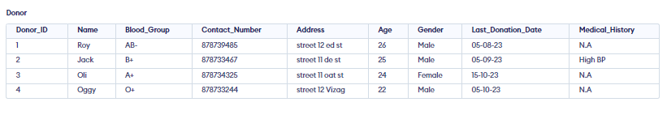
DONOR TABLE

Slide 8
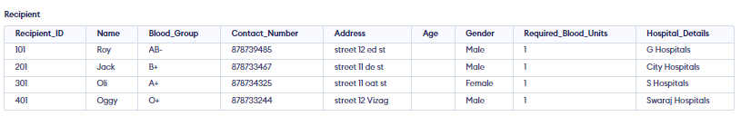
RECIPIENT TABLE

Slide 9
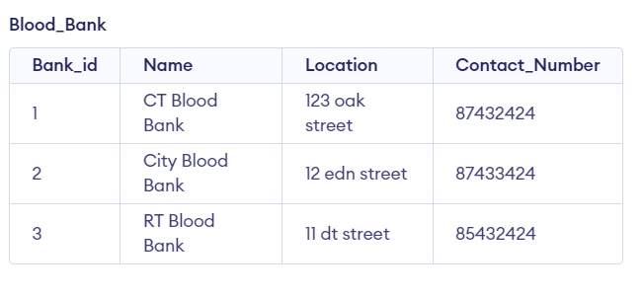
BLOOD BANK TABLE

Slide 10
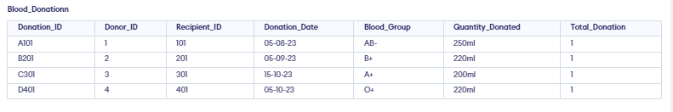
BLOOD DONATION TABLE

Slide 11
OUTPUT FOR VIEW
 | Donor_ID | Name | Blood_Group | Contact_Number | Address | Age | Gender | Last_Donation_Date | Total_Donations
 | 1 | Roy | AB- | 878739485 | street 12 ed st | 26 | Male | 05-08-23 | 1
 | 2 | Jack | B+ | 878733467 | street 11 de st | 25 | Male | 05-09-23 | 1
 | 3 | Oli | A+ | 878734325 | street 11 oat st | 24 | Female | 15-10-23 | 1
 | 4 | Oggy | O+ | 878733244 | street 12 Vizag | 22 | Male | 05-10-23 | 1

Slide 12
OUTPUT FOR TRANSACTION
Donor Table (Updated Last Donation Date for Jack
 | Donor_ID | Name | Blood_Group | Contact_Number | Address | Age | Gender | Last_Donation_Date | Total_Donations
 | 1 | Roy | AB- | 878739485 | street 12 ed st | 26 | Male | 05-08-23 | 1
 | 2 | Jack | B+ | 878733467 | street 11 de st | 25 | Male | 15-09-23 | 1
 | 3 | Oli | A+ | 878734325 | street 11 oat st | 24 | Female | 15-10-23 | 1
 | 4 | Oggy | O+ | 878733244 | street 12 Vizag | 22 | Male | 05-10-23 | 1

Slide 13
OUTPUT FOR TRANSACTION
Blood_Donation Table (New Entry for Jack’s Donation):
 | Donation_ID | Donor_ID | Donation_Date | Blood_Group | Quantity_Donated
 | B201 | 2 | 05-08-23 | B+ | 220ml
 | B201N | 2 | 25-10-23 | B+ | 240ml

Slide 14
CONCLUSION
The completion of the Blood Bank Management System project is a significant achievement in the way blood banks and healthcare facilities operate. This system shows the power of using advanced technology to improve critical healthcare processes.
As discussed in the project how required details can be fetched easliy by simple processess.

Slide 15
THANK YOU!
Devesh Rawat AP22110010038
Praneeth Bulusu AP22110010049
Kolla Rahul AP22110010052
Maddula Vignesh AP22110010016

